Slide 1

Standard Specification update
Matt Looney
KYTC, Division of Construction
February 6, 2018
Matt.looney@ky.gov

Slide 2
Division Committee Chairs
100 Mark Walls
200 Danny Jasper
300 Austin Shields
400 Vibert Forsythe
500 Erika Drury and Rob Franxman
600 Ryan Gossom
700 Katy Stewart
800 Michael Black

Slide 3
Overall Schedule?
Originally hoped to be published for use in all Lettings in 2018.
KAR revisions (claims)
Some edits took more time than anticipated to complete
  Get it right vs. Get it done….

Slide 4


Overall Schedule?

Slide 5
This presentation….
Focus on revisions that will affect the day to day life for a Section Office.
Overrun/Underrun Section 104
Claims 105.13 (major revision)
Use of Explosives 107.11
Fuel Adjustment 109.07.02
Demobilization schedule 110.04

Slide 6
This presentation (cont.)….
Asphalt Material for Tack as a Pay item 406
Microsurfacing 413 (new section)
Dowel Bar and Tie Bar Placement (JPC) 502
  Formerly JPC 24/48/72
Concrete changes in table 601.03.03

Slide 7
This presentation (cont. (cont.))….
Complete rewrite of Bearing Piles 604
Major revision to Maintenance Cleaning and Painting of Steel Bridges 614
Add Inlaid Pavement Markers 712
Roadway Lighting & Signal Systems 716, 723, 834, 835
  Major revisions

Slide 8
This presentation (cont.³)….
New MASH Guardrail 719 (January 2018)
Crash Cushions 725
Pipe 810

Slide 9
Overrun/Underrun Section 104
Adding option to adjust minor item pricing if final quantity is at least 200% above original contract quantity.
Excessive underrun formula calculated based on Original Contract Quantity.

Slide 10
Claims 105.13 (major revision)
New forms
  TC 63-77, TC 63-78 Notice and Acknowledgement of Potential Claim
Contractor required to submit weekly documentation of all items involved with work relating to potential claim.
New subsections for Claims for Extra work vs. Claims for Delays
HOLD

Slide 11
Claims 105.13 (cont.)
Extra work claims
  Breakdown of Recoverable vs. Non-recoverable costs
Delay Claims
  Details Excusable/Non-Excusable/Concurrent
  Details Compensable vs. Non-Compensable delays
  Details recoverable expenses

Slide 12

Claims 105.13 (cont.)
Contractor must establish entitlement in the final claim submittal
  Must submit a narrative of the details of the claim
  Must submit Impact and Cost statement
  Must submit signed and notarized Certification of claim

Slide 13

Use of Explosives 107.11
Expands greatly on existing language in Specification
Adds language from special notes into the specification.
  No new requirements over note which was being added to all projects that required blasting.

Slide 14
Fuel Adjustment 109.07.02
Remove ‘Structural Category Concrete, Class A, AA, AAA, & A Modified’ as adjustable items
Add two words to 109.07.03
  “Original Contract”
  Moving forward, it will be clarified that supplemental items will not be eligible for adjustment. Pricing from contractor should reflect current indexes.

Slide 15
Demobilization Schedule 110.04
Pay
  25% upon Project Completion (Work Complete notice sent)
  50% upon Formal Acceptance
  Remaining 25% to be paid with final estimate
    Unchanged – 180 days from formal acceptance, all but $1000 can be paid on request of the contractor

Slide 16


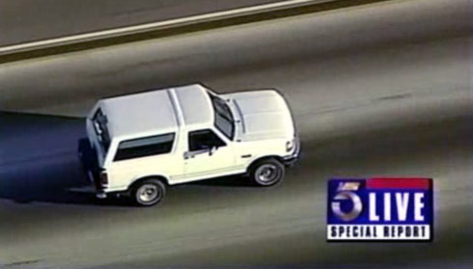
Flashback to a simpler time…..
1994

Slide 17
Asphalt Material for Tack as Pay 406
Effective with Supplemental Specifications to the February 2018 letting.
Weights should be taken by the contractor before and after placement of Tack. Tickets given to inspection staff on the project.
Paid in Tons
Keep up with application rate during production by gauges on the distributor.

Slide 18
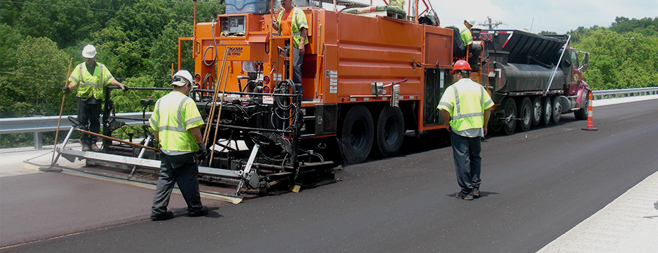
Microsurfacing 413 (new section)
Familiar requirement that had been in place previously as special note added to the contract.
Section addition places requirements in as Standard Specifications.

Slide 19
Dowel Bar and Tie Bar Placement (new subject for Section 502)
Familiar requirement that had been in place previously as proposal/plan note added to the contract.
Section addition places requirements in as Standard Specifications.
Not specifying the 24/48/72 hour mixes, but these will likely still be used at the discretion of the contractor to accommodate traffic control.

Slide 20
Changes to concrete table in
Section 601.03.03
Maximum allowable slump increases from 4” to 5” for Class A and Class AA concrete.
Note 13 was added to the table
  Requirements for consistent slump
    slump NOT to vary more than 2” from previous load
  Minimum Water/Cement ration to be set at 0.28

Slide 21

Bearing Piles 604
Finally removed old power formulas and other equipment requirement that had been obsolete for some time.
Removed any reference to concrete piles
More closely resembles the notes that have been used in structure plans

Slide 22
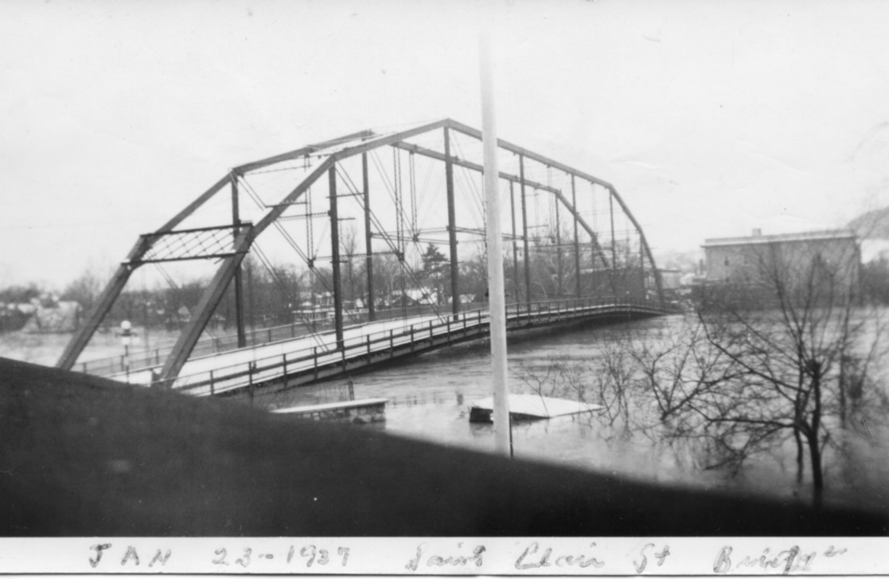
Maintenance Cleaning and Painting of Steel Bridges 614
Updating specification to more closely match notes and requirements for these projects that have been in contracts for some time.

Slide 23
Inlaid Pavement Markers 712
Rename 712 and remove ‘Raised’ from title
Add information from current notes for Inlaid pavement markers to the Standard Specification.

Slide 24
New Guardrail Standards 719
Changes effective 12/31/17
January 2018 Supplemental
  31” mounting height
  Mid-span splice

Slide 25
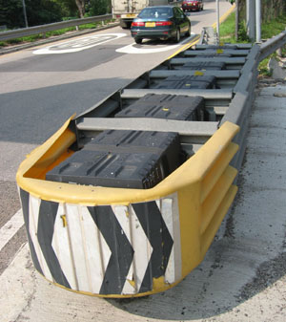
Crash Cushions 725
Removed the systems called out by name from the Specifications.
Reference to Standard Drawings

Slide 26
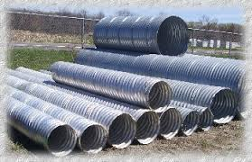
Pipe and Pipe Arches 810
Pipes greater than 30” in diameter must have identifying stencil
  Inside wall of pipe
  3” stencil size
  Must identify class of pipe

Slide 27
Division 800
Numerous changes and updates
Contact me if you would like access to a copy of the latest Draft version of the updates.
Matt.looney@ky.gov
(502) 782-5151
  (email is more reliable to actually find me)

Slide 28


THANK YOU!

